Slide 1

BF3 DPU MEM Failure Fix Guideline

Slide 2
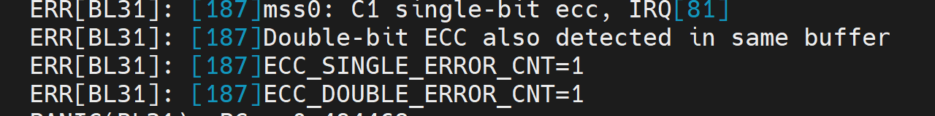
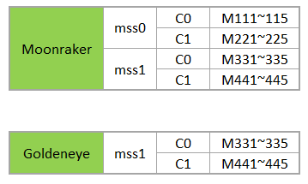
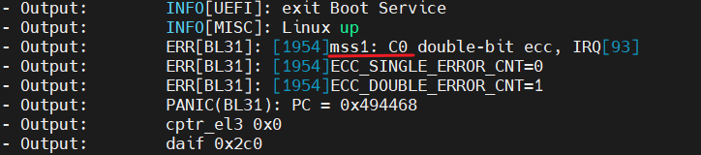
Memory candidate location
M221~225
M331~335

Slide 3
MEM failure instructions
The unit must run FT testing released after 2024/5, if the unit failed in DPU MEM before 2024/5 and does not have the latest FT test result, please run the FT offline testing first.
If the DPU MEM failure passes the DDR tool, please re-test it in offline. If it also passes offline testing, please release it to the online.
The DDR tool detects only one memory, please replace the memory directly then run it to the offline testing, if the unit fails please run the DDR tool again.

Slide 4
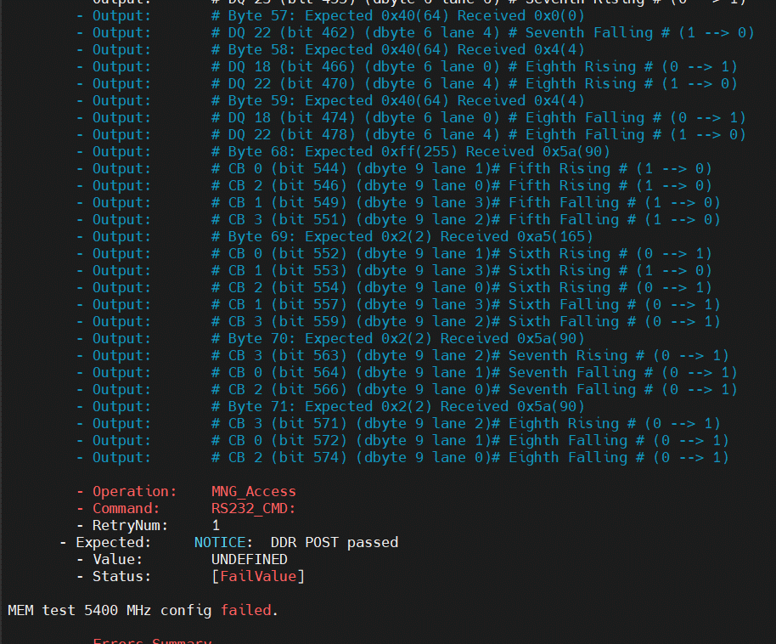
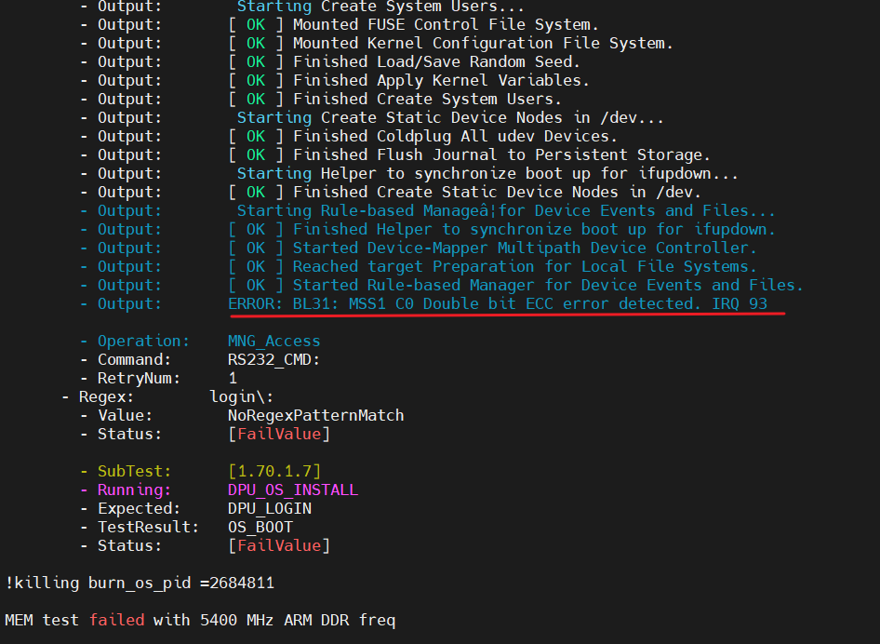
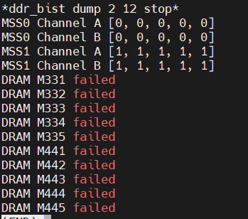
MEM failure instructions
If all memories failed in DDR tool, and the ft log likes below, please request NV to replace the BGA.

